Slide 1
Ideas & how to present
Be concise (30 min total, time it), slides targeting "general audience"
More visual
Short demo (5 min)
“If you can’t explain it you don’t understand it” ☺
Start with a quote – ‘Man, learn yourself” © who? End with a smile ☺
History – 30 years in dev (time to adVenture), resume (university project), fail, CudaCube, epic fail (github), now what?
No AI experience – good or bad? Q to you. Facts and bits collection and sifting through, maiTrixToDo.txt #1 – 107, 10 years, Physarum
Back to basics. What is it? What do we all need? From Physarum to Sapiens. Min efforts -> max result, example #1, from random to 2 spirals, before Physarum!
Genesis
Elements, no, elementals. Again, follow neuroscience #104-106.
Why no one else can understand it? TED Sebastian Seung, Connectome Project. Analogy – Neanderthal & CPU picture also CPU schema vs Turing machine diagram. “Commonsense psychology” article. “The Devil is in the details”, L Perlovsky as example
Music. Free for all. Know thyself at the end w/chatgpt quote & engineering task #108!
“Timing is the key” © myself
Extended version / technical / future design and completeness boundaries (2-3 years), may already be ready – GPU CAD, signal modelling systems, MathWorks, Cellular Automata & Mathematica by Wolfram, Adrian Thompson's Hardware Evolution (FPGA), & can’t recall name

Slide 2

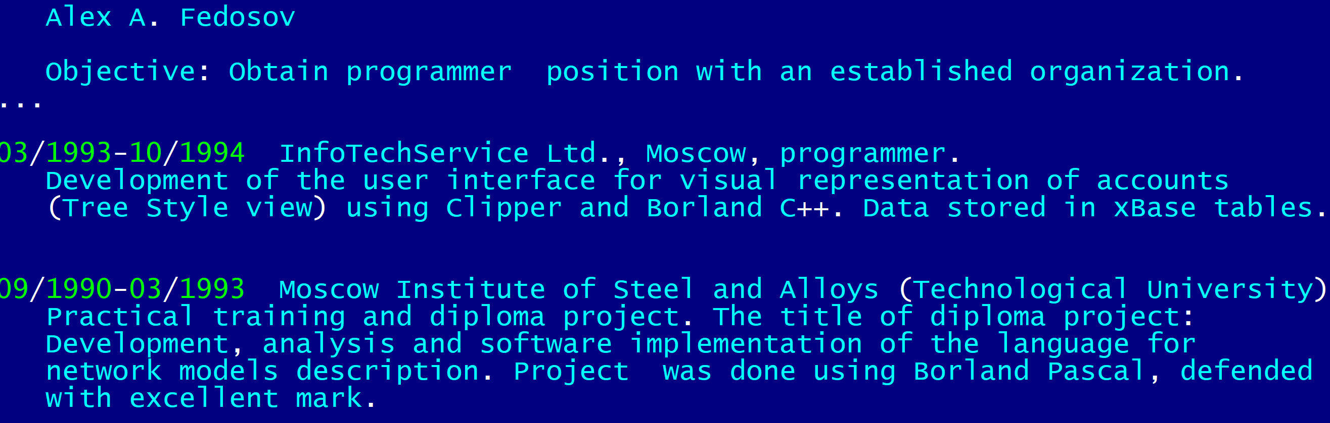
Be honest. Be humble. Be bold. AI and beyond.
Γνῶθι σεαυτόν / Know thyself

Slide 3
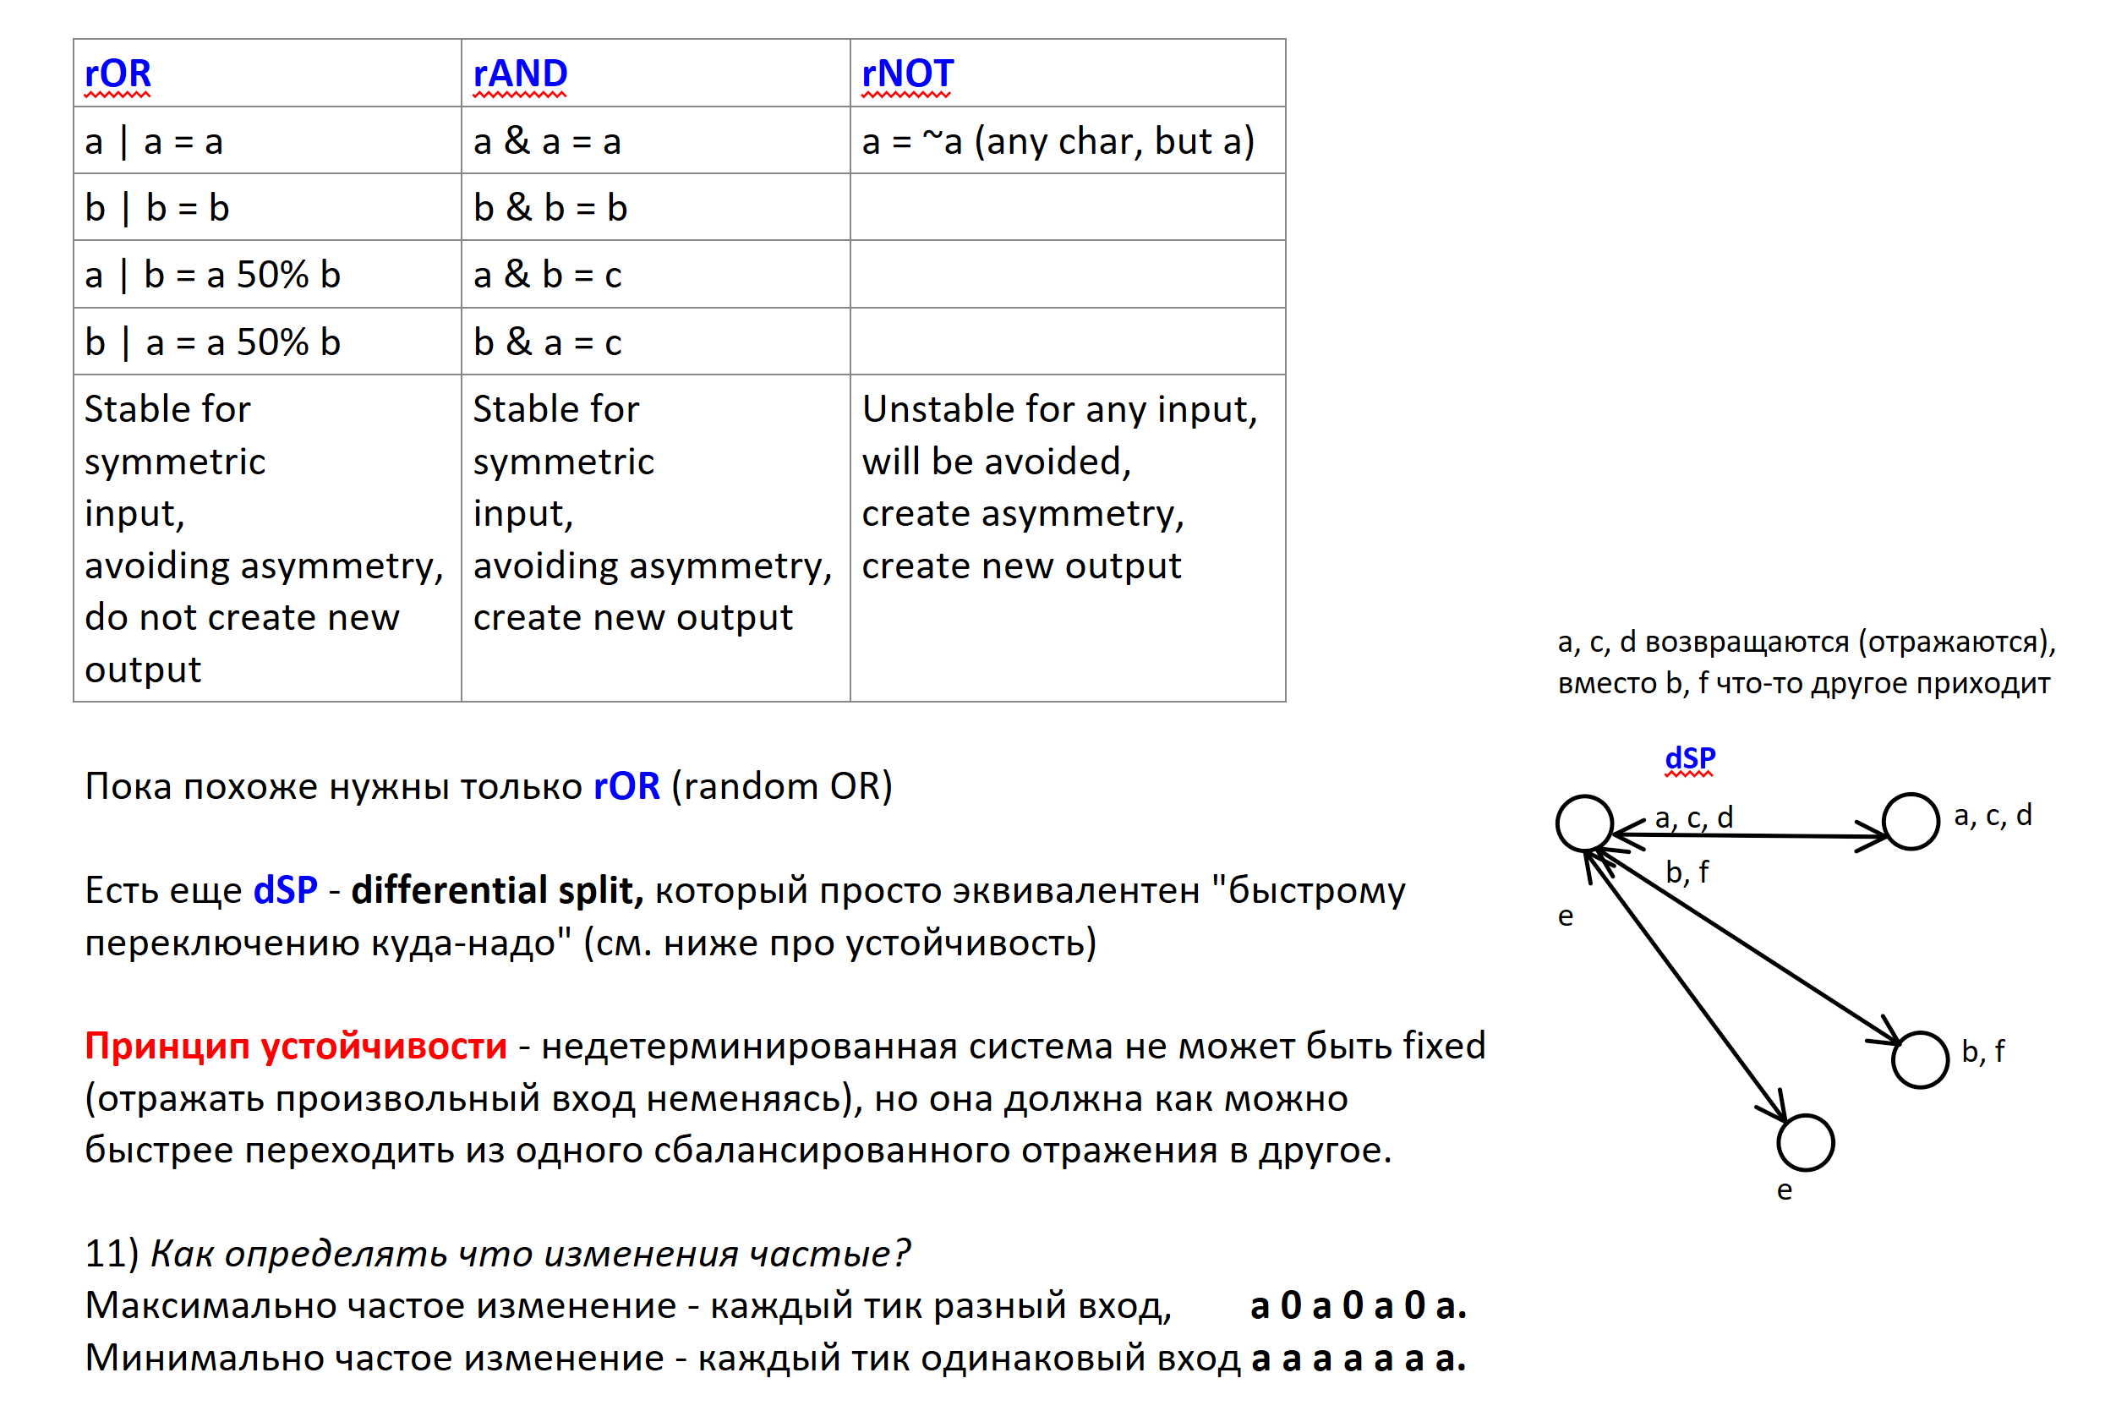
First idea. Implementation. Fail.

Slide 4
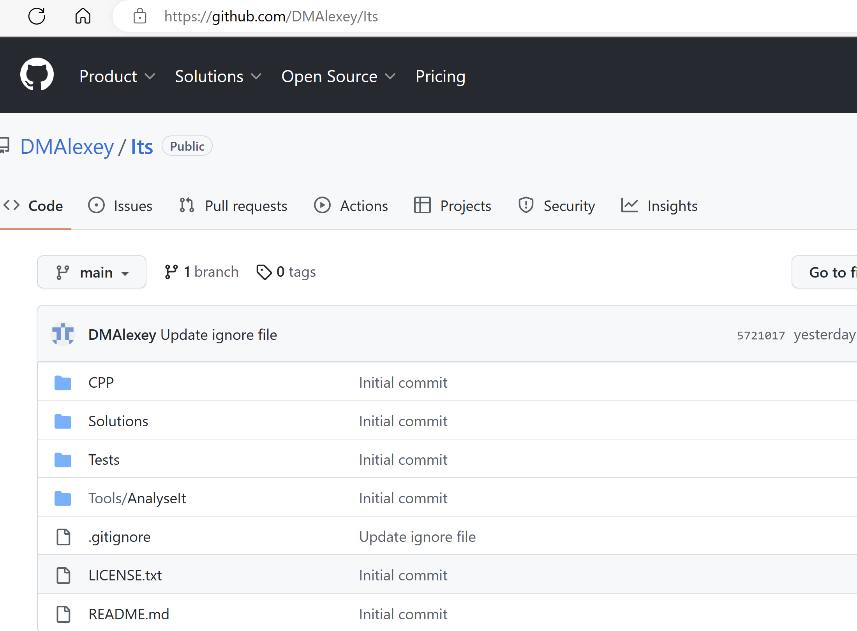
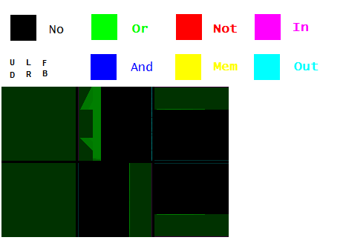
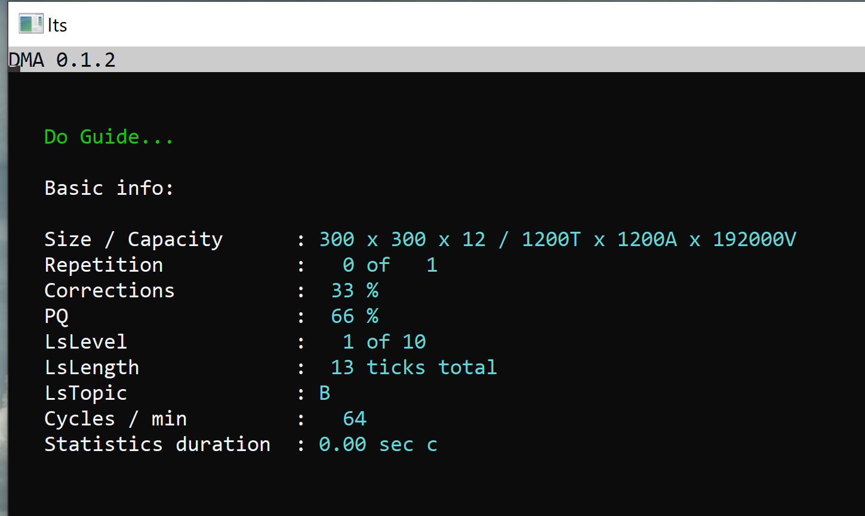
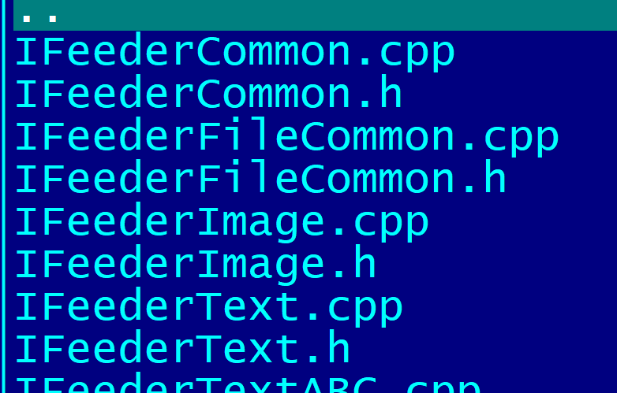
First idea. Implementation. Fail.
The model is powered by Nvidia Cuda SDK / 12 GPU / SIMD
13 projects / 40k LOC / unit testing / demo

Slide 5
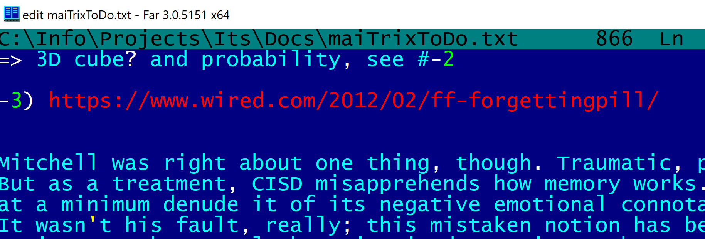
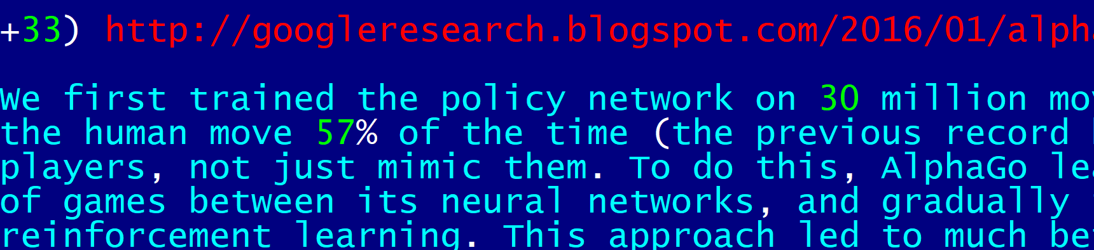
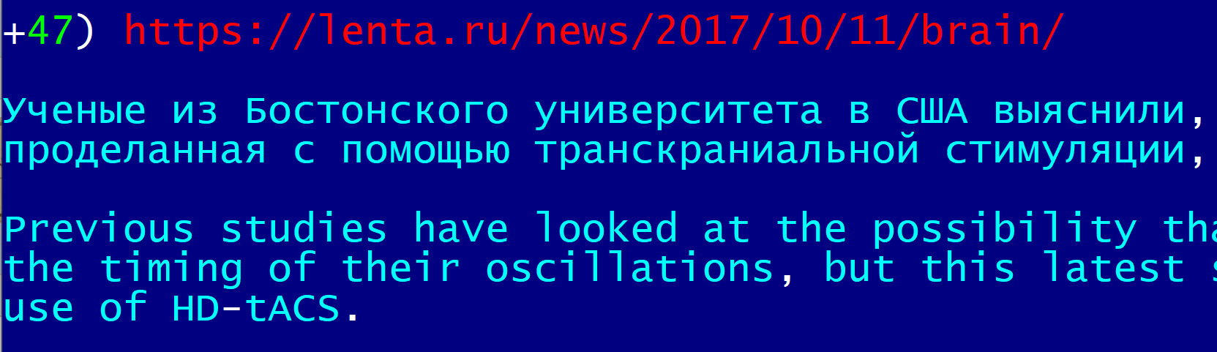
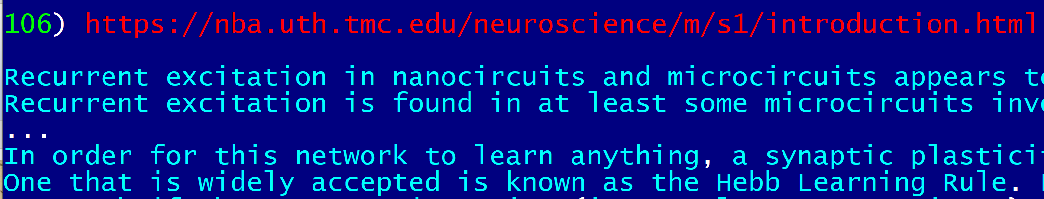
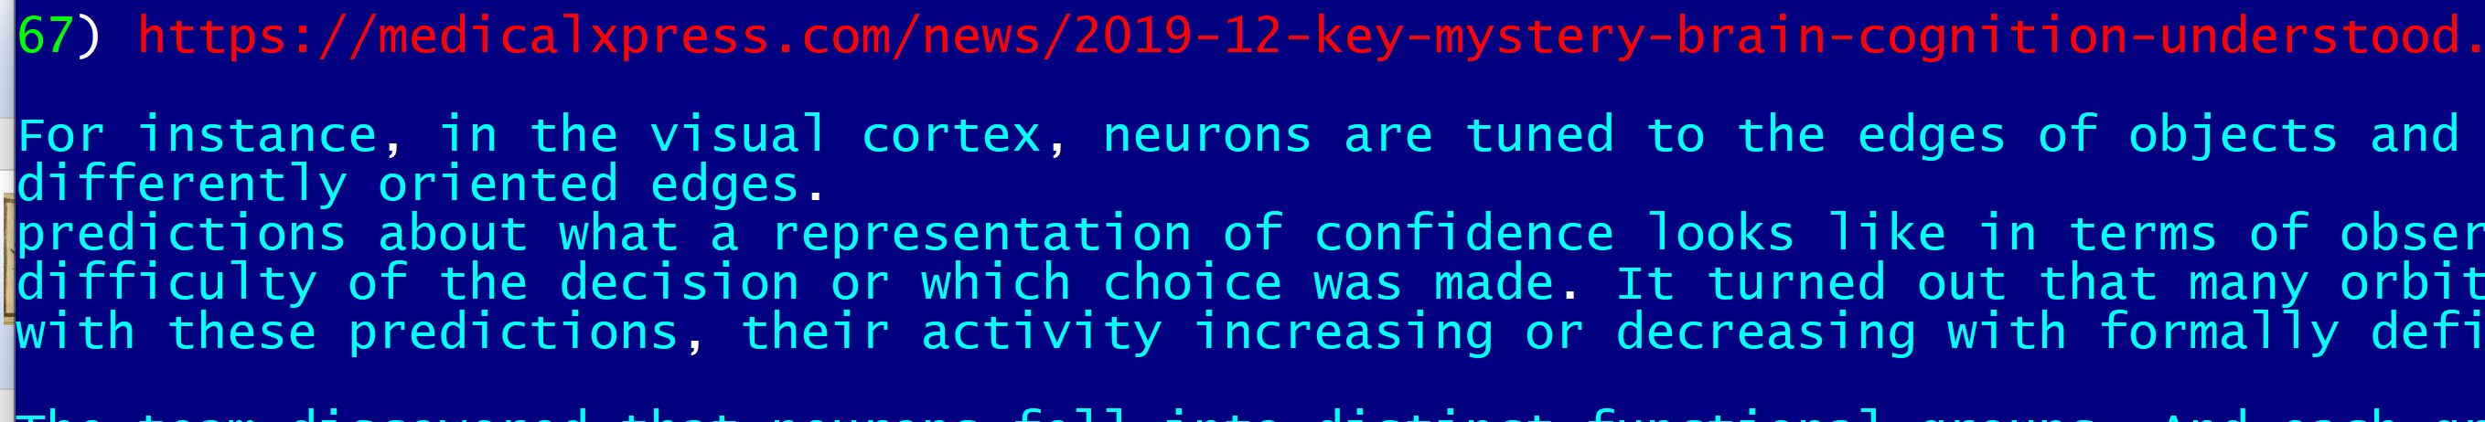
Back to basics. Bits and pieces.
10 years of sifting through facts, models,
white papers, abstracts of academic research papers & Thinking……….. remodeling…… thinking again
No AI experience. Is it good or bad? ;-)

Slide 6
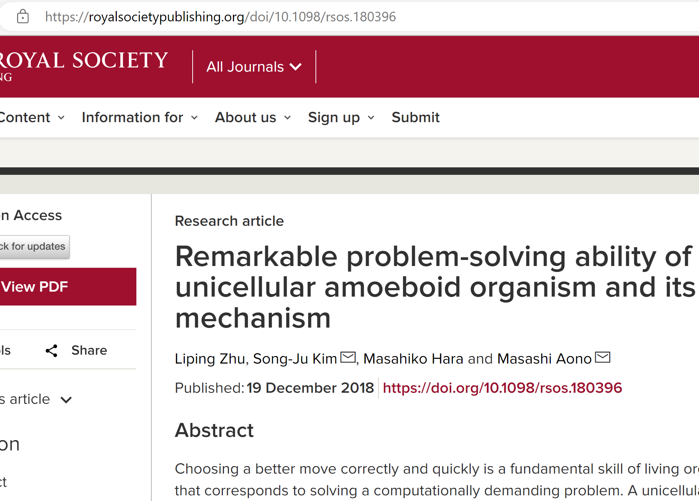
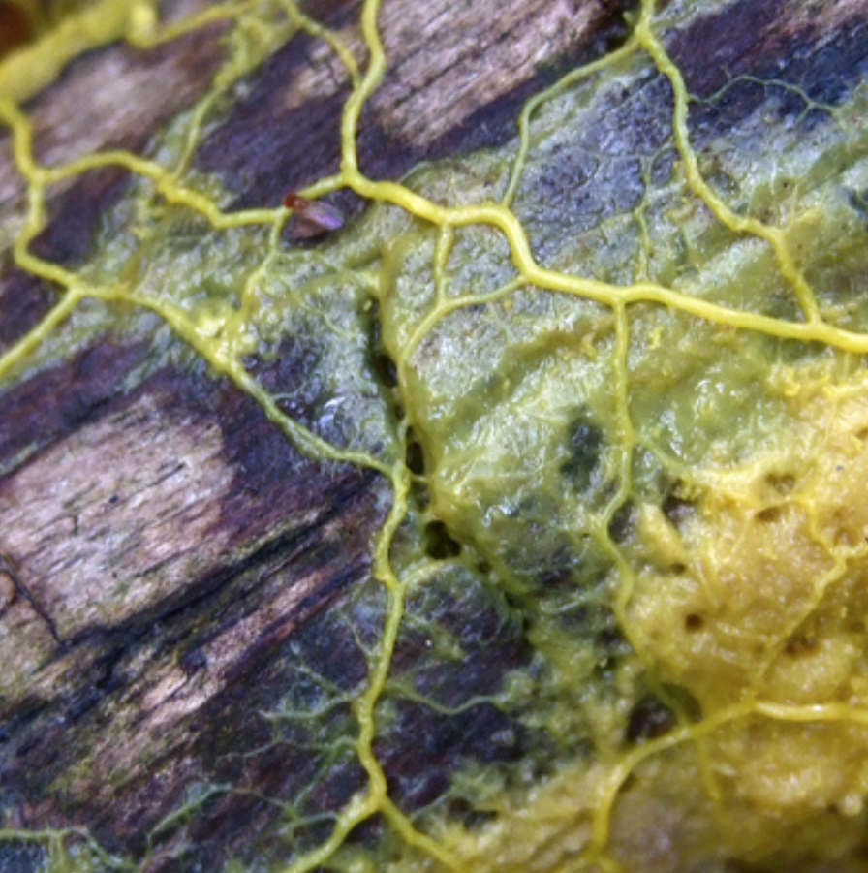
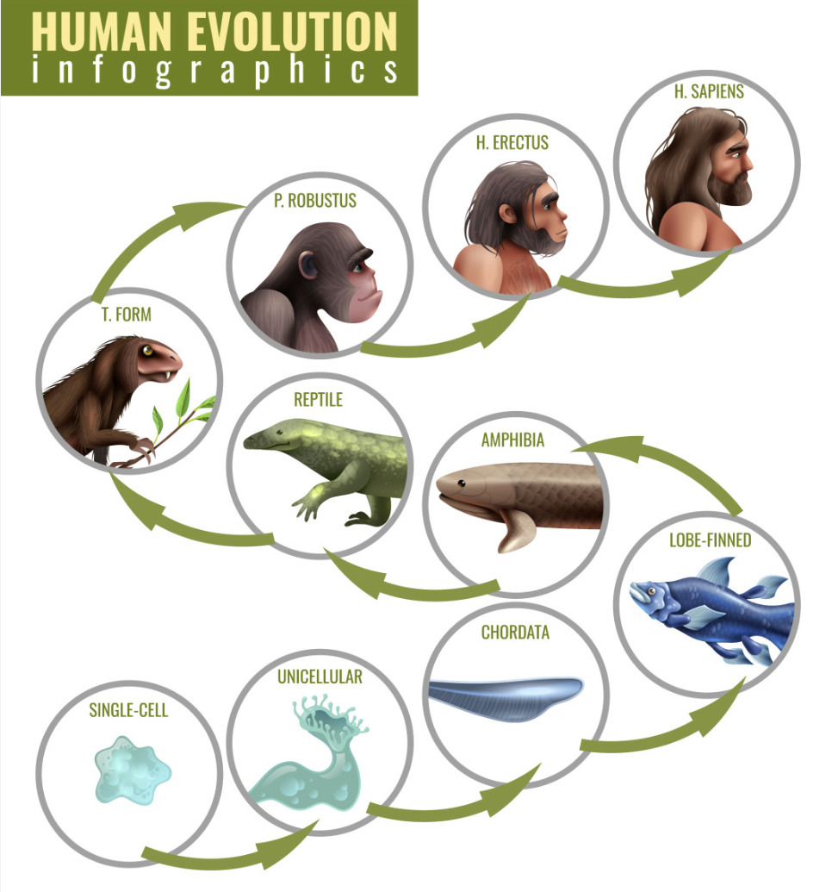
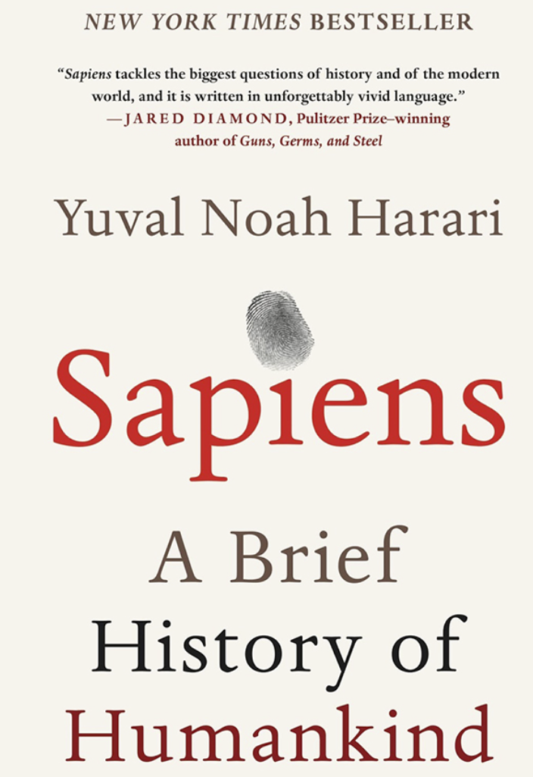
Back to basics. Physarum.
Physarum polycephalum can solve TSP (Travelling salesman problem, NP-hard) in polynomial time.
How?
Min efforts -> Max result

Slide 7
Back to basics. Physarum. How?
Dig deeper. Stage 0. Pre-Physarum.
Random search. Ineffective but works, till now. AI level 0
Min efforts -> Max result

Slide 8
Back to basics. Physarum. How?
Dig deeper. Stage 1. Pre-Physarum. Invertor.
Random search with start/stop. More effective, works anywhere, evolutionary beneficial. Out with 2 speeds, inverted from In. AI level 1
Min efforts -> Max result

Slide 9
Back to basics. Physarum. How?
Dig deeper. Stage 2. Pre-Physarum. Tracking.
Tracking search with start/stop. Super effective, works anywhere. 2 Outs with 2 speeds, inverted from In. AI level 1.5
Min efforts -> Max result

Slide 10
Back to basics. Physarum. How?
Dig deeper. Stage 3. Pre-Physarum. Spiral.
Tracking search with start/stop. 2 Outs with 2 speeds each, inverted from In with 2 controllers, analyzing short and long periods. AI level 2
Min efforts -> Max result

Slide 11
Back to basics. Physarum. How?
Dig deeper. Stage 4. Physarum. Optimization.
Tracking search with start/stop. 2 Outs with 2 speeds each, inverted from 2 Ins with 2 controllers, analyzing short and long periods. AI level - ∞
Min efforts -> Max result

Slide 12
Back to basics. Physarum. How?
Dig deeper. Why spiral is important?
Outward and inward tracking spirals effectively cover 2D surface, approximating food search (TSP) with polynomial time solution. AI level - ∞
Min efforts -> Max result

Slide 13
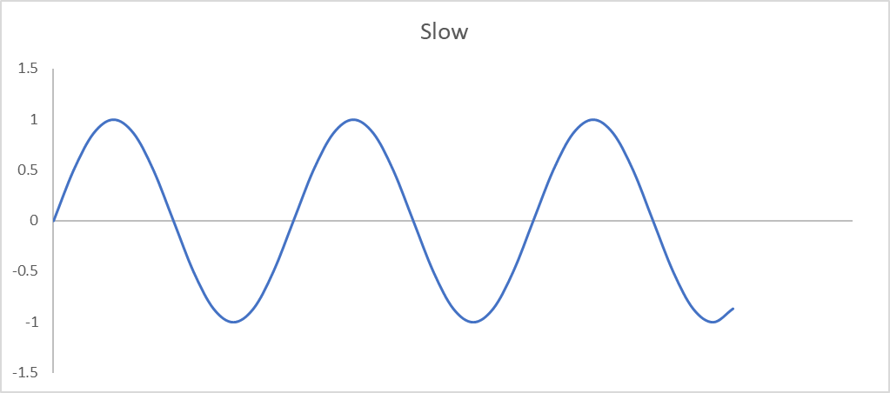
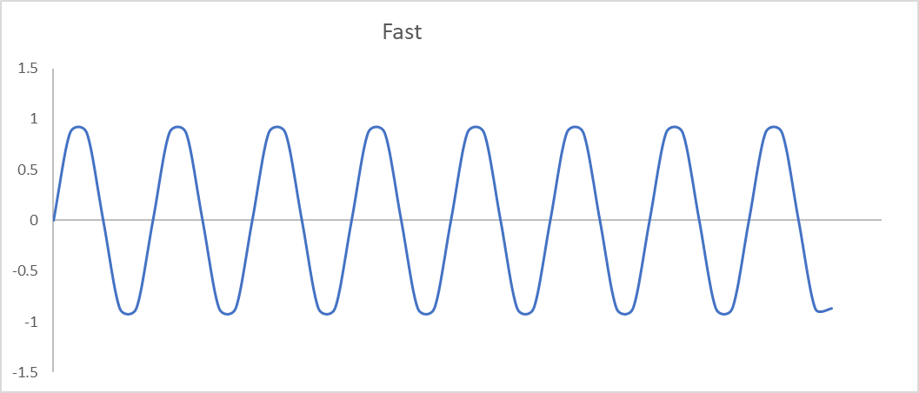
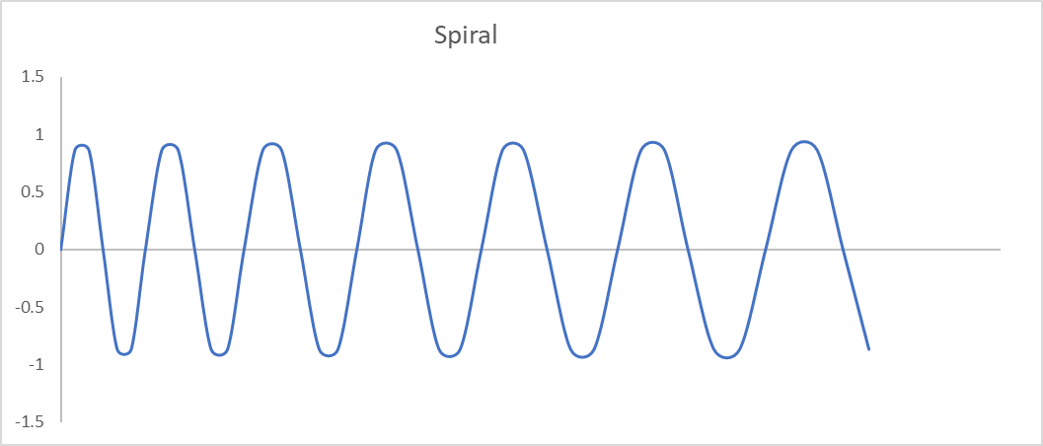
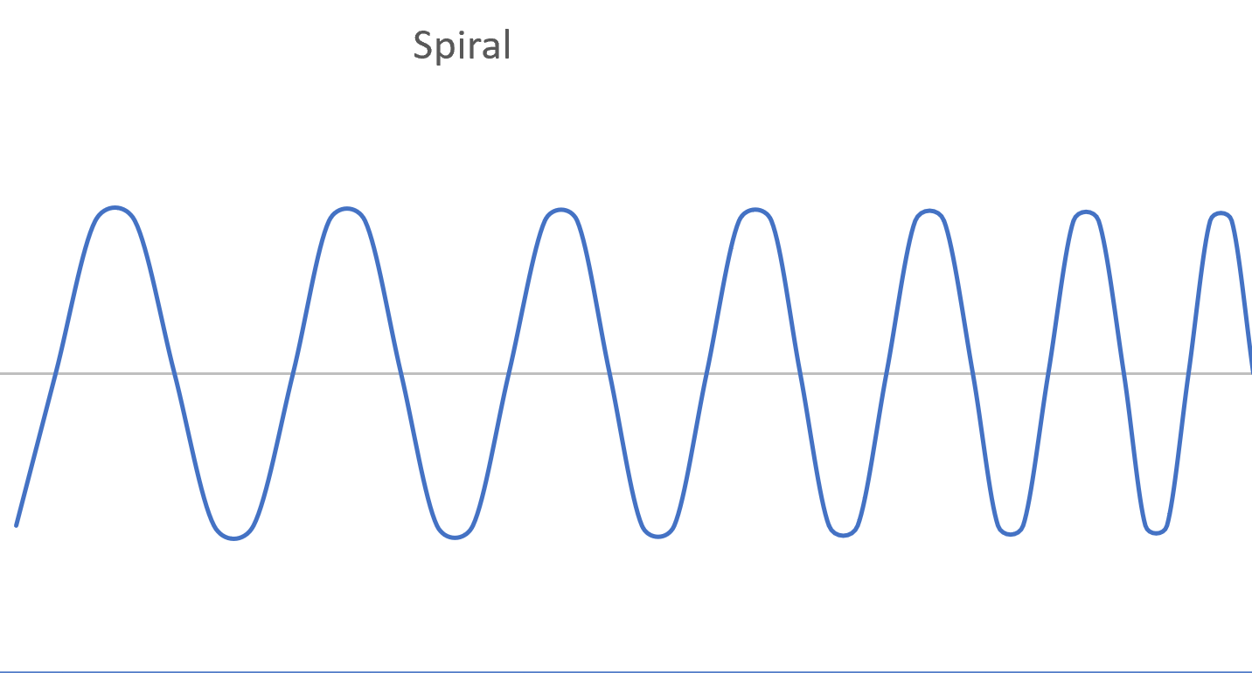
Implementation. Basics.
Invertor Tracking Spiral
Freq F Freq S
Freq LF Freq LS
Freq RF Freq RS
Invertor – slow down when found something;
Tracking - not necessary LF=RF and LS=RS, this is not “spatial inversion”, but similar to Invertor, “temporal inversion” – slow down when found something;
Spiral requires continuous harmonics addition / subtraction;

Slide 14
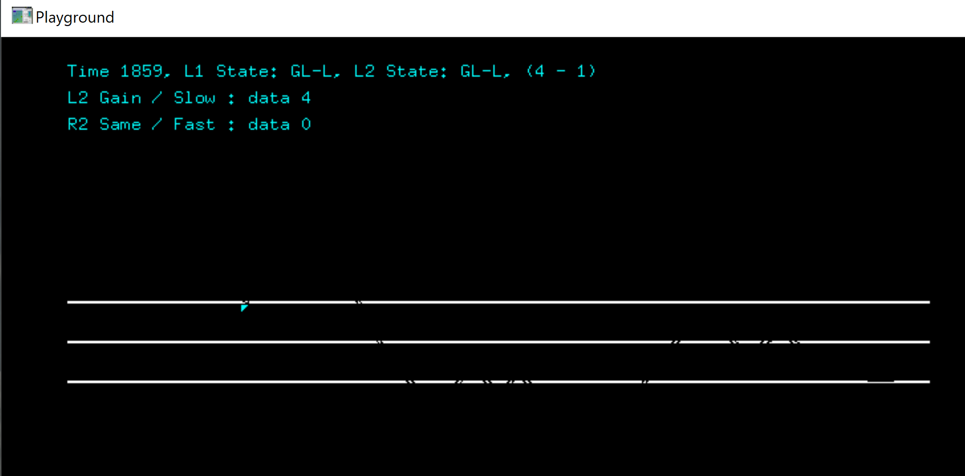
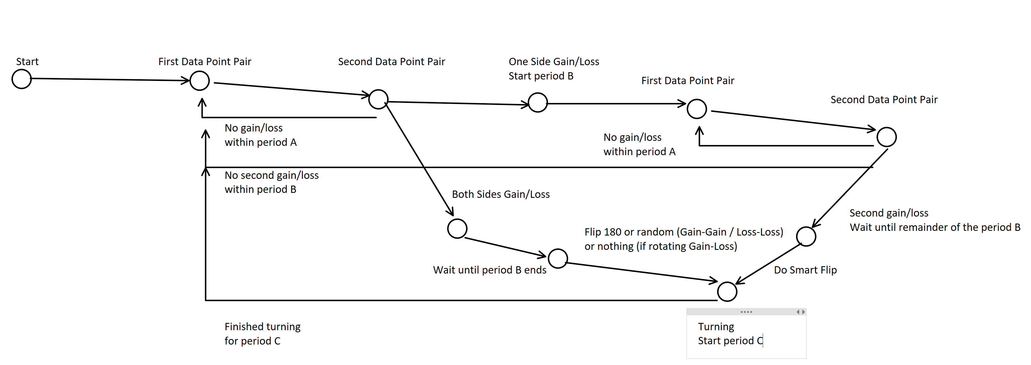
Implementation. Demo.
Tracking with 2nd level, “almost spiral”. Implementation – C++/OpenGL, state machine on both levels, 1k LOC, end-to-end testing.
Hypothesis: Multi-leveled tracking spiral is sufficient solution for the main task on all AI levels “Min efforts -> Max result”, which is NP-hard and beyond.
Question:
Is this elementary implementation? No.

Slide 15
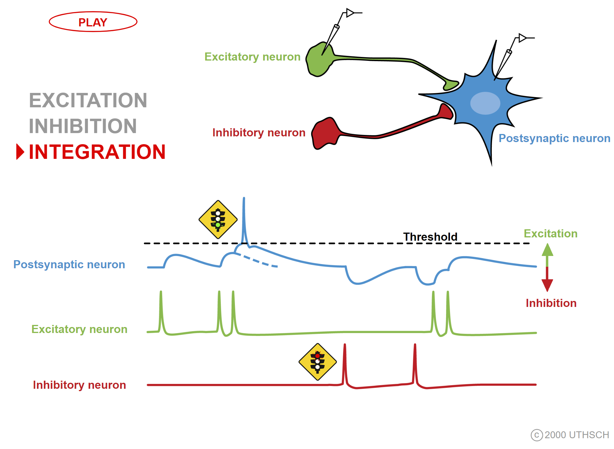

Implementation. Elementals.
(GEN)
Cell
Random search, non-stop
Freq fixed,
few base “tones”
(GENSS)
Cell
Freq fixed, start/stop
(INV)
There are a few precise models for neurons;
Feedback delay may vary, affecting frequency but not too much, otherwise it can’t be stopped;
Feedback delay may be != Input delay, thus generation frequency may differ from reaction frequency;
Cell
Smart search, start-stop
Freq inverted

Slide 16
Implementation. Genesis.
In
Out
In
Out1
GENSS
GENSS
INV
Out2
INV
Better invertor implementation
“Almost tracking”
In
Out1
GENSS
Out2
Few interim (evolutional) implementations omitted for simplicity;
Timing is the key;
Not reacting to signals, but to absence of signals within certain period;
Reached Physarum AI level? Maybe!
There’s a catch – won’t work for low frequency signals. How to solve?
GENSS
Out2
Out1
INV
INV
Tracking,
implementation by duplication

Slide 17

Implementation. Camertones.
3 bits / sec
(CMTN)
GEN1 freq. 1
In
Out
5 bits / sec
GEN2 freq. 2
Cell
7 bits / sec
GEN3 freq. 3
(1/105) bits / sec
………
(INV ‘)
See slide #15, GEN frequency can very, but not much;
Timing is the key, obertones intersection;
Frequencies should not necessarily be prime numbers, but better be pairwise prime;
Think of CMTN as slow GEN;
In
Out
CMTN
Cell

Slide 18
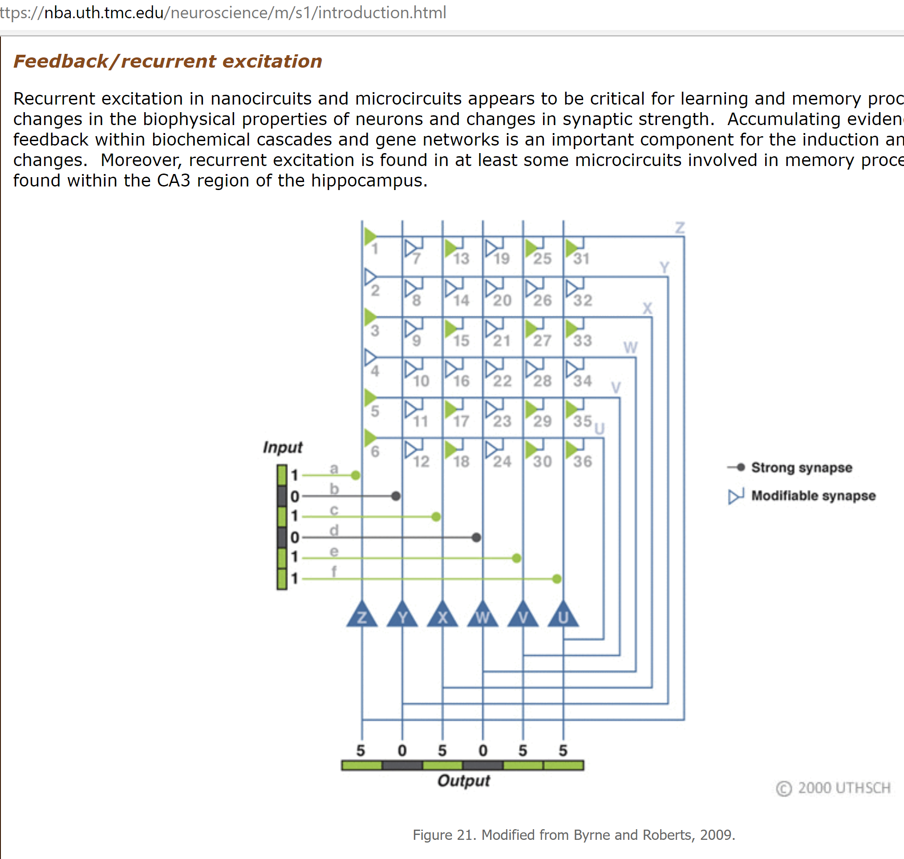
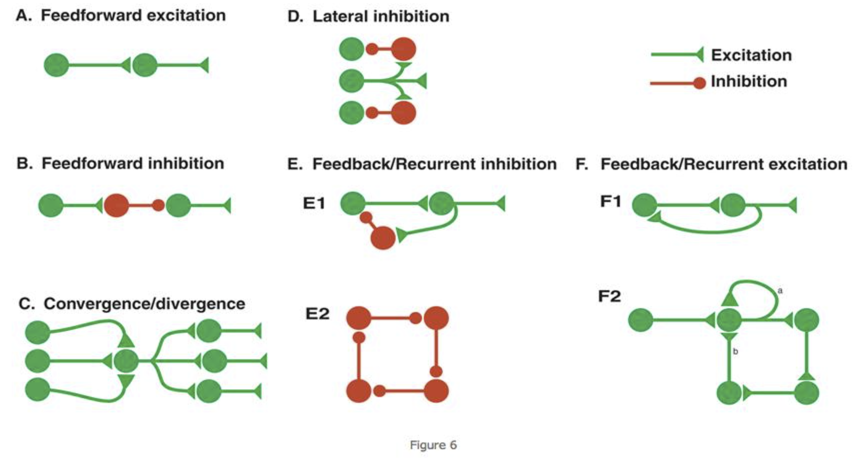
Implementation. Magic.
Neuroplasticity (LTP/LTD/STDP),
sAHP, “spike frequency adaptation”

Slide 19
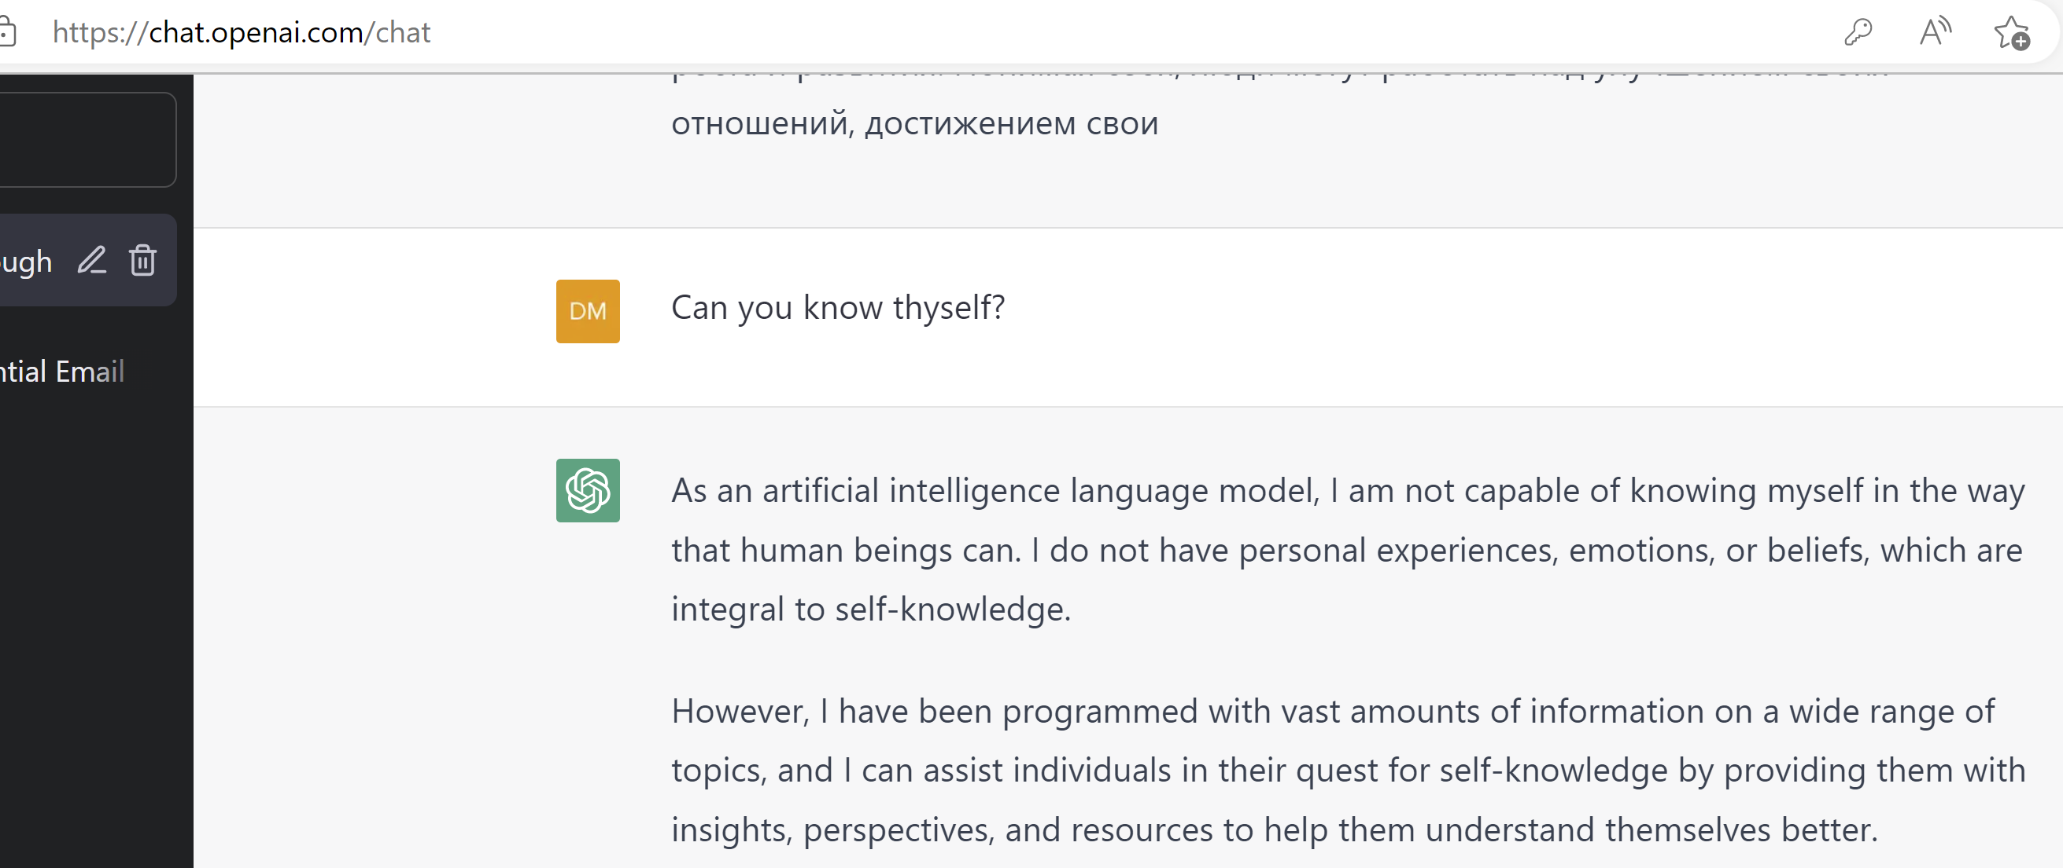
Back to the future
Valid answer. But can we do better? ;-)

